Slide 1
Log4j
logging framework

Slide 2
Agenda
Log4j overview.
Logger Setup
Logging methods Logger class.
Logger levels Log4j properties file.
Log4j file appender. Log4j multiple appenders Log4j xml file.

Slide 3
Log4j Overview

Slide 4
Log4j
Log4j is a simple, flexible and fast java based logging framework. It is thread safe and supports

Slide 5
Log4j Main Components
1. Logger: It is used to log the messages.
2. Appender: It is used to publish the logging information to the destination like file, database, console etc.
3. Layout: It is used to format logging information in different styles.

Slide 6
Advantage of Log4j
It provides the easy maintenance and fast debugging

Slide 7
Disadvantage of Log4j
It slow down the application.

Slide 8
Logging methods
1. debug(Object message): It is used to print the message with the level Level.DEBUG.
Syntax: public void debug(Object message)
2. error(Object message): It is used to print the message with the level Level.ERROR.
Syntax: public void error(Object message)
3. info(Object message): It is used to print the message with the level Level.INFO.
Syntax: public void info(Object message)
4. fatal(Object message): It is used to print the message with the level Level.FATAL.
Syntax: public void fatal(Object message)
5. warn(Object message): It is used to print the message with the level Level.WARN.
Syntax: public void warn(Object message)
6. trace(Object message): It is used to print the message with the level Level.TRACE.
Syntax: public void trace(Object message)

Slide 9
Log4j setup

Slide 10
Log4j setup
Download log4j.zip (Apache log4j 1.2.17 (zip)) file from https://logging.apache.org/log4j/1.2/download.html
Extract the zip file, take the log4j.jar file and add the log4j.file to your project classpath

Slide 11
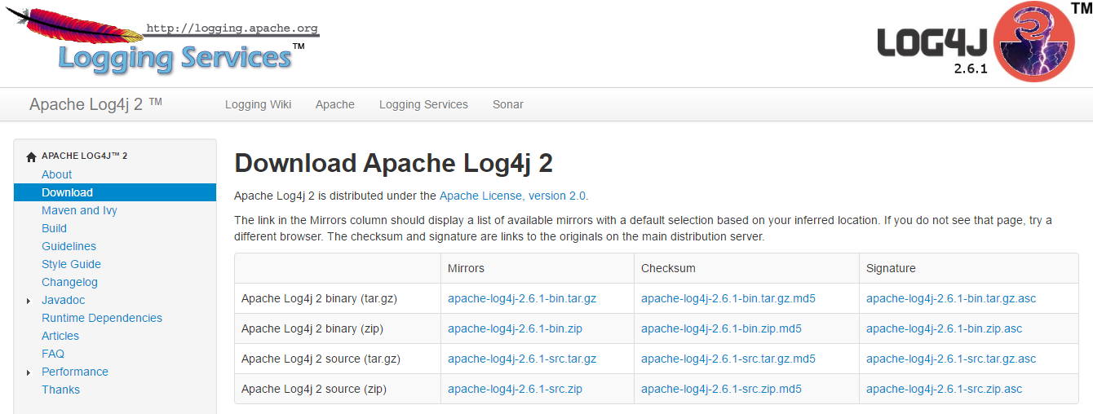

Slide 12
Logger class

Slide 13
Logger class
Logger class provides the methods for logging process. We can use the getLogger() method to get the Logger object.
Syntax: public static Logger getLogger(String name);
Where name is the fully qualified class name.

Slide 14
Log4j example( w/o properties and configuration files)
In this example we use BasicConfigurator for Log4j configurations. BasicConfigurator use ConsoleAppender and PatternLayout for all loggers

Slide 15
Log4jTest
/** * This class is used to show the use of * Log4j with the BasicConfigurator. */
public class Log4jTest {
private static Logger log = Logger.getRootLogger();
//private static Logger log = Logger.getLogger(Log4jTest.class);
public static void main(String[] args) {
//set logger level
log.setLevel(Level.INFO);
// Configuring Log4j,It will log all messages on console.
// BasicConfigurator use ConsoleAppender and PatternLayout //for all loggers.
BasicConfigurator.configure();
//BasicConfigurator.configure(); //comment and see the output
//logger messages
log.debug("log4j debug text");
log.info("log4j info text"); }}

Slide 16
Output
0 [main] DEBUG root - log4j debug text
1 [main] INFO root - log4j info text

Slide 17
Logging levels:
All logging levels are defined in the org.apache.log4j.Level class. We can also create our own levels.

Slide 18
Logger levels
1. ALL: All levels including custom levels also.
2. DEBUG: It helps developers in application debugging.
3. INFO: It gives the information about the progress of application and its states.
4. WARN: It gives warning for unexpected events.
5. ERROR: It provides the information about error events.
6. FATAL: It provides the information about application abort.
7. OFF: It turns off all the logging. It is opposite to the ALL level.
Standard order of all logging levels:
ALL < DEBUG < INFO < WARN < ERROR < FATAL < OFF.
i.e. If logging level set to FATAL then only FATAL messages will be displayed, if logging level set to ERROR then ERROR and FATAL messages will be displayed and so on.
- See more at: http://tutorialspointexamples.com/logging-levels-in-log4j-example-tutorial/#sthash.kxgYp2Cy.dpuf

Slide 19
I am developing a large commercial program and keep confusing myself between what kind of information i want to log with Log.INFO and Log.DEBUG. Are there any standards or rules of thumb on what each type of log message contains?
DEBUG: Information interesting for Developers, when trying to debug a problem.
INFO: Information interesting for Support staff trying to figure out the context of a given error
WARN to FATAL: Problems and Errors depending on level of damage.

Slide 20
Logging Pattern:
If you want to generate your logging information in a particular format based on a pattern, then you can use org.apache.log4j.PatternLayout to format your logging information.

Slide 21
Logger levels
PatternLayout is also a simple Layout object that provides the following-Bean Property which can be set using the configuration file:
conversionPattern Sets the conversion pattern. Default is %r [%t] %p %c %x - %m%n

Slide 22
Pattern Conversion Characters
Conversion Character | Meaning
c | Used to output the category of the logging event. For example, for the category name "a.b.c" the pattern %c{2} will output "b.c".
C | Used to output the fully qualified class name of the caller issuing the logging request. For example, for the class name "org.apache.xyz.SomeClass", the pattern %C{1} will output "SomeClass".
d | Used to output the date of the logging event. For example, %d{HH:mm:ss,SSS} or %d{dd MMM yyyy HH:mm:ss,SSS}.
F | Used to output the file name where the logging request was issued.
l | Used to output location information of the caller which generated the logging event.
L | Used to output the line number from where the logging request was issued.
m | Used to output the application supplied message associated with the logging event.
M | Used to output the method name where the logging request was issued.
n | Outputs the platform dependent line separator character or characters.
p | Used to output the priority of the logging event.
r | Used to output the number of milliseconds elapsed from the construction of the layout until the creation of the logging event.
t | Used to output the name of the thread that generated the logging event.
x | Used to output the NDC (nested diagnostic context) associated with the thread that generated the logging event.
X | The X conversion character is followed by the key for the MDC. For example, X{clientIP} will print the information stored in the MDC against the key clientIP.
% | The literal percent sign. %% will print a % sign.

Slide 23
Note
Here
C is to print Classname
c is to print category
d is to print date

Slide 24
Log4j properties file

Slide 25
Log4j.properties
log4j.rootLogger=DEBUG, CA
#Set Console Appender
log4j.appender.CA=org.apache.log4j.ConsoleAppender
#CA uses PatternLayout
log4j.appender.CA.layout=org.apache.log4j.PatternLayout

Slide 26
Note
put the log4j.properties under src folder or create classes folder and put the properties file under that.

Slide 27
Log4jTest with Properties file
public class Log4jTest {
private static Logger log = Logger.getRootLogger();
// private static Logger log = Logger.getLogger(Log4jTest.class);
public static void main(String[] args) {
// logger messages
log.debug("log4j debug text");
log.info("log4j info text");
}
}

Slide 28
Log4j file appender

Slide 29
Log4j.properties
#log4j.rootCategory=INFO,DEBUG,A1,LFS,FA,CA log4j.rootLogger=DEBUG, FA #Set File Appender log4j.appender.FA=org.apache.log4j.FileAppender log4j.appender.FA.File=test.log #Set FA Layout log4j.appender.FA.layout=org.apache.log4j.PatternLayout log4j.appender.FA.layout.ConversionPattern=%d{dd-MMM-YYYY HH:mm:ss } %m%n

Slide 30
Log4jTest
public class Log4jTest {
private static Logger log = Logger.getRootLogger();
// private static Logger log = Logger.getLogger(Log4jTest.class);
public static void main(String[] args) {
// logger messages
log.debug("log4j debug text");
log.info("log4j info text");
log.warn("log4j warn text");
log.error("log4j error text");
log.fatal("log4j fatal text");
}
}

Slide 31
Log4j multiple appenders example

Slide 32
log4j.properties
#log4j.rootCategory=INFO,DEBUG,A1,LFS,FA,CA log4j.rootLogger=DEBUG, CA, FA #Set Console Appender log4j.appender.CA=org.apache.log4j.ConsoleAppender #Set CA Layout log4j.appender.CA.layout=org.apache.log4j.PatternLayout log4j.appender.A1.layout.ConversionPattern=%m%n #Set File Appender log4j.appender.FA=org.apache.log4j.FileAppender log4j.appender.FA.File=test.log #Set FA Layout log4j.appender.FA.layout=org.apache.log4j.PatternLayout log4j.appender.FA.layout.ConversionPattern=%m%n #Set the logging level of FA to WARN log4j.appender.FA.Threshold = WARN

Slide 33
public class Log4jTest {
private static Logger log = Logger.getRootLogger();
// private static Logger log = Logger.getLogger(Log4jTest.class);
public static void main(String[] args) {
// logger messages
log.debug("log4j debug text");
log.info("log4j info text");
log.warn("log4j warn text");
log.error("log4j error text");
log.fatal("log4j fatal text");
}
}

Slide 34
Log4j XML

Slide 35
Log4j.xml
<?xml version="1.0" encoding="UTF-8" ?>
<!DOCTYPE log4j:configuration SYSTEM "log4j.dtd">
<log4j:configuration xmlns:log4j='http://jakarta.apache.org/log4j/'>
<appender name="CA" class="org.apache.log4j.ConsoleAppender">
<layout class="org.apache.log4j.PatternLayout">
<param name="ConversionPattern" value="%m%n" />
</layout>
</appender>
<root>
<level value="info" />
<appender-ref ref="CA" />
</root>
</log4j:configuration>

Slide 36
public class Log4jTest {
private static Logger log = Logger.getRootLogger();
// private static Logger log = Logger.getLogger(Log4jTest.class);
public static void main(String[] args) {
// logger messages
log.debug("log4j debug text");
log.info("log4j info text");
log.warn("log4j warn text");
log.error("log4j error text");
log.fatal("log4j fatal text");
}
}

Slide 37
Source: http://tutorialspointexamples.com/logging-levels-in-log4j-example-tutorial/

